Slide 1

Sepsis and Public Health
Hasan Gokal MD
Emergency Response Physician
Office of Public Health Preparedness and Response
WWW.HCPHTX.ORG

Slide 2
Sepsis and Public Health Objectives
Demonstrate the role of Public Health in the prevention of Sepsis.
01
Show how sepsis is following down the path of historically successful public health programs.
02
Expose the audience to the many unused tools of public health which are available for Sepsis prevention.
03

Slide 3
Does a Sepsis discussion even belong in Public Health?
Sepsis is not a single entity
Sepsis does not have a single causative agent
Sepsis does not effect a single demographic
Sepsis does not always present the same way

Slide 4
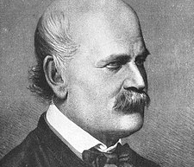
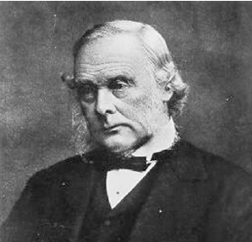
Public Health and Sepsis have a long history
In the 1800’s, Drs. Semmelweiss and Lister successfully managed to reduce the incidence of Sepsis in the hospitals through the use of now-common anti-septic techniques

Slide 5
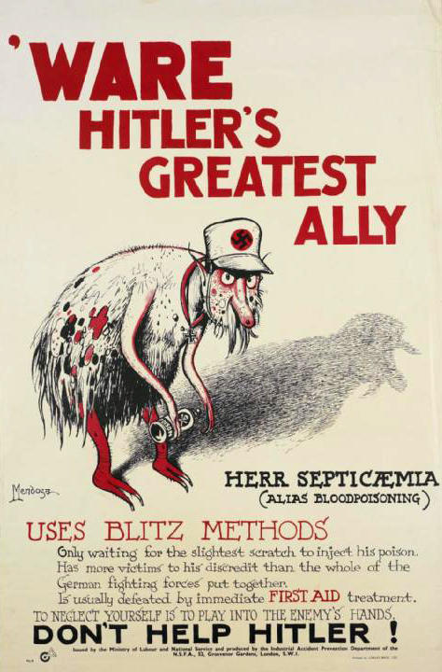
Public Health Messaging to prevent sepsis were present long before treatments were available.

Slide 6
Moving from the ICU to the Streets – The evolution of a Disease Entity
Interventions are Hospital Based Only
Resource Intensive
Difficult to identify
Difficult to treat
Unpredictable Pattern
Tertiary Care Only
Intervention Impacts Hospital Interface (ED/EMS)
Needs resources to identify
Time sensitive
Incidence must be significant
Some patterns start to manifest
Secondary Care
Community Impacts Possible
Patterns of Risk factors and demographics identified
Incidence must be high
Treatments should be available
Can be recognized by laypersons
Greatest Public Health Impact
Primary Care

Slide 7
Examples of Public Health Successes using the same Primary/Secondary/Tertiary Framework
Heart Disease
Stroke

Slide 8
1920’s-1961 - – James Herrick: Bed rest was the only real treatment.
Identification of LDL/HDL and Framingham data
Tertiary Care
1961 – CCU was developed for ECG monitoring, closed chest resuscitation, external defibrillation, and in-hospital mortality was reduced by half.
1970’s-1980’s – Use of Cardiac marker for early detection
1980’s-1990’s – Availability of therapeutic options
Evolution of Heart Disease As an Example.
Rapid ED recognition and coordination of interventions
1990’s – Pre-hospital identification and transmission of ECG improved outcomes
Secondary Care
Specialized facilities with pre-hospital coordination of EMS
Smoking Cessation Efforts
Diet Modification Recommendations
Aggressive Cholesterol Management
Primary Care/Prevention
Public Health Messaging targeted towards recognition and speed of getting care
Widespread availability of AED’s
Education programs for laypersons (CPR)

Slide 9
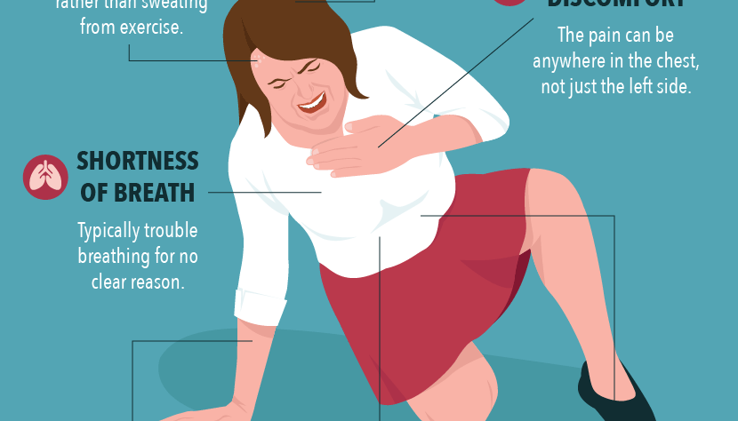
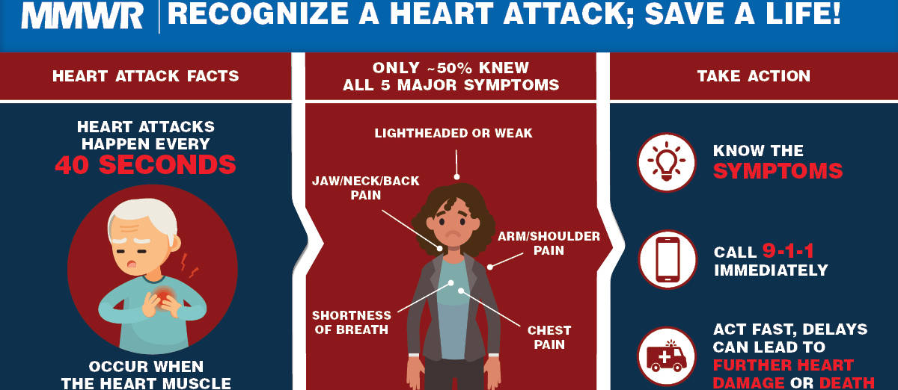
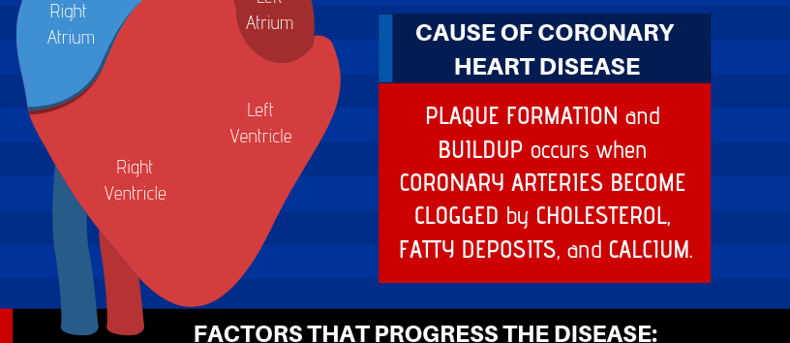
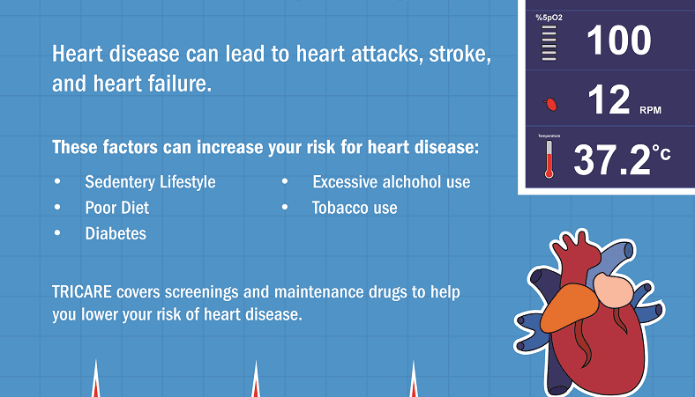

Slide 10
1600s – Jacob Wepfer connected blood supply disruption to the brain with stroke
Until 1990s Treatment was limited to managing new disabilities.
Tertiary Care
Evolution of Stroke As an Example.
1996 TPA approved for use in certain CVA’s
2004 Mechanical thrombectomy increased treatment options
Secondary Care
Lipid control, dietary modification, blood pressure control and aspirin an were among the mainstays of prevention, along with carotid endarterectomies
Stroke centers with specific capabilities developed, and EMS services were taught to select the most appropriate facility.
Primary Care/Prevention
Beyond preventive measures, public health education taught people how to recognize signs of stroke, and the need for speed in obtaining care.

Slide 11
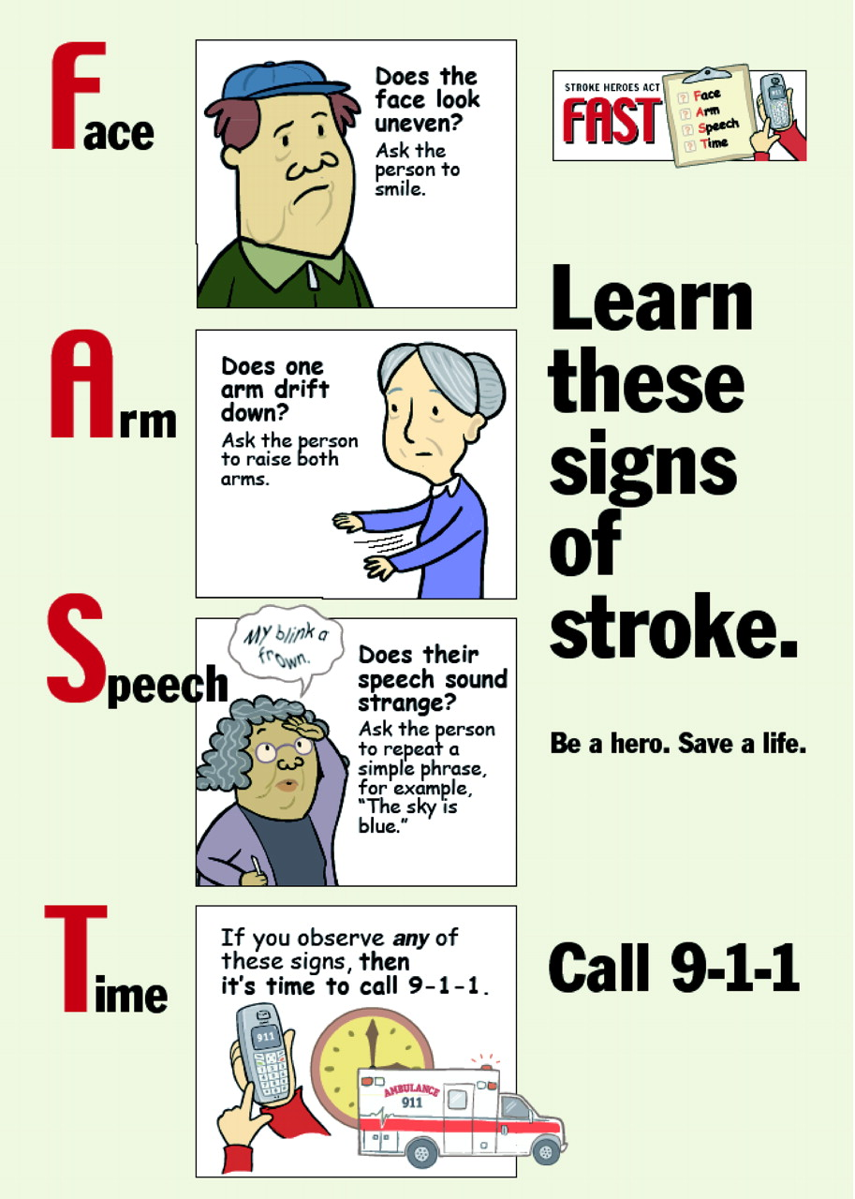
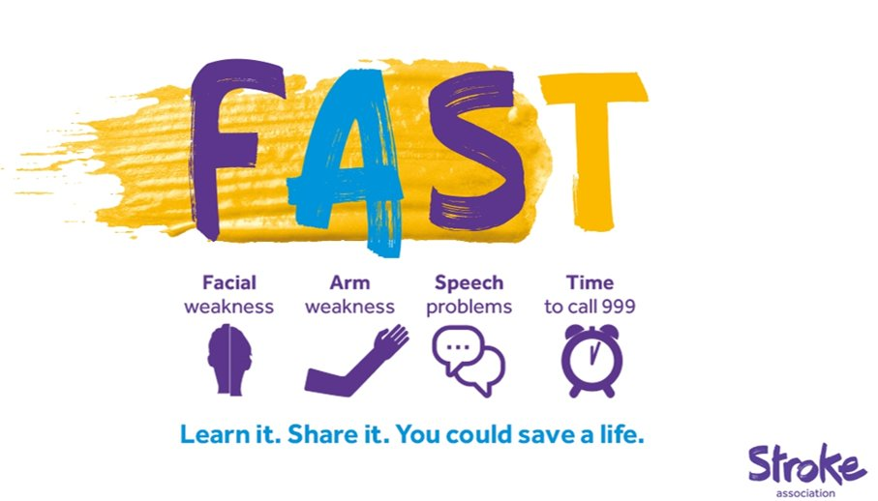

Slide 12
When can public health make the maximum impact?

Slide 13
When can public health make the maximum impact?
High Public Burden of Illness

Slide 14
When can public health make the maximum impact?
High Public Burden of Illness
High Incidence

Slide 15
When can public health make the maximum impact?
High Public Burden of Illness
High Incidence
Availability of Treatments

Slide 16
When can public health make the maximum impact?
High Public Burden of Illness
High Incidence
Availability of Treatments
Ability to Identify Illness Early

Slide 17
When can public health make the maximum impact?
High Public Burden of Illness
High Incidence
Availability of Treatments
Ability to Identify Illness Early
Identifiable Risks and Demographics

Slide 18

Getting There
Extremes of age
Primary diseases
Immunosuppression
Major procedures
Previous antibiotic treatment
Prolonged hospitalization
Others
1.1 Million per year
250,000 deaths per year
Yes

Slide 19
1964 – Edward Frank publishes first septic shock strategy
1992 – First definition of Sepsis published in CHEST
Tertiary Care
2001 Evidence based guidelines for early management of sepsis emerged
SIRS/Golden Hour/EGDT
Applying the Primary/Secondary/Tertiary framework to Sepsis
2004 Surviving Sepsis Campaign Starts – Help clinicians recognize and treat sepsis
Secondary Care
Public Messaging targeting physician and high risk populations
2010 Lactate clearance utility described
2017 WHO raised sepsis as a priority
2018 CDC Releases Hospital Toolkit for Sepsis
Increasing public awareness of Sepsis through CDC, WHO, and groups like Sepsis Alliance
Primary Care/Prevention

Slide 20
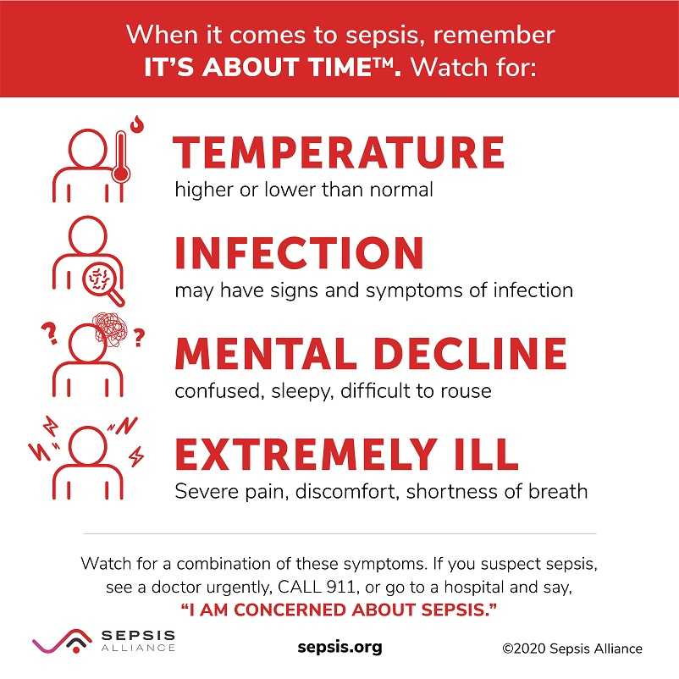
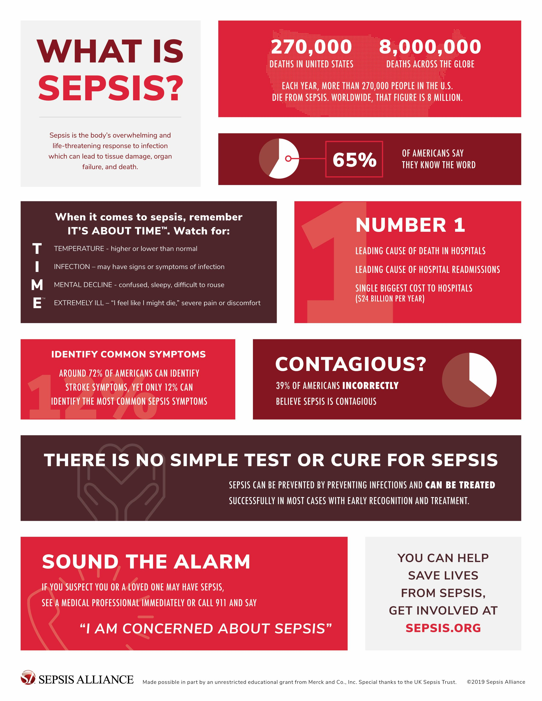

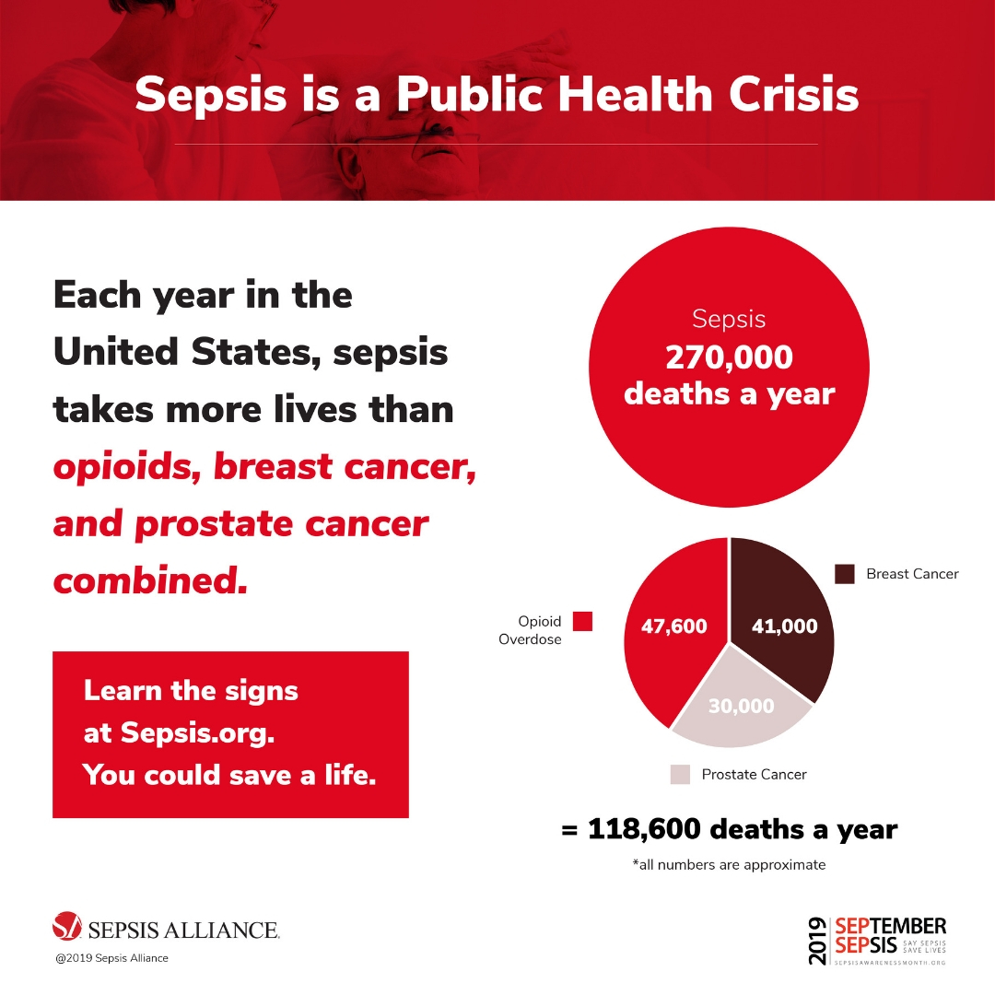

Slide 21
Educate officials
Identify and remove roadblocks (ex data sharing)
Break barriers to prevent access
Funding for study and education
Align with other groups for funding (such as cancer prevention)
Vaccinations for vulnerable populations
Improved management of chronic diseases in certain populations
Epidemiologic and Data support
Common Definitions (CDC Toolkit)
Antibiotic utilization and resistance patterns
Data-sharing from other countries (WHO)
Wider layperson training
Help capture cases among non-vulnerables
Make it as ubiquitous as MI/CVA education
Target Diabetics, Immunosuppressed, Advanced age, Post-procedures
Recognition Training
Time Sensitivity Focus
Involve Caregivers
Provider Awareness Education
Vulnerable Patient Teaching Tools
Antibiotic guidance

Slide 22
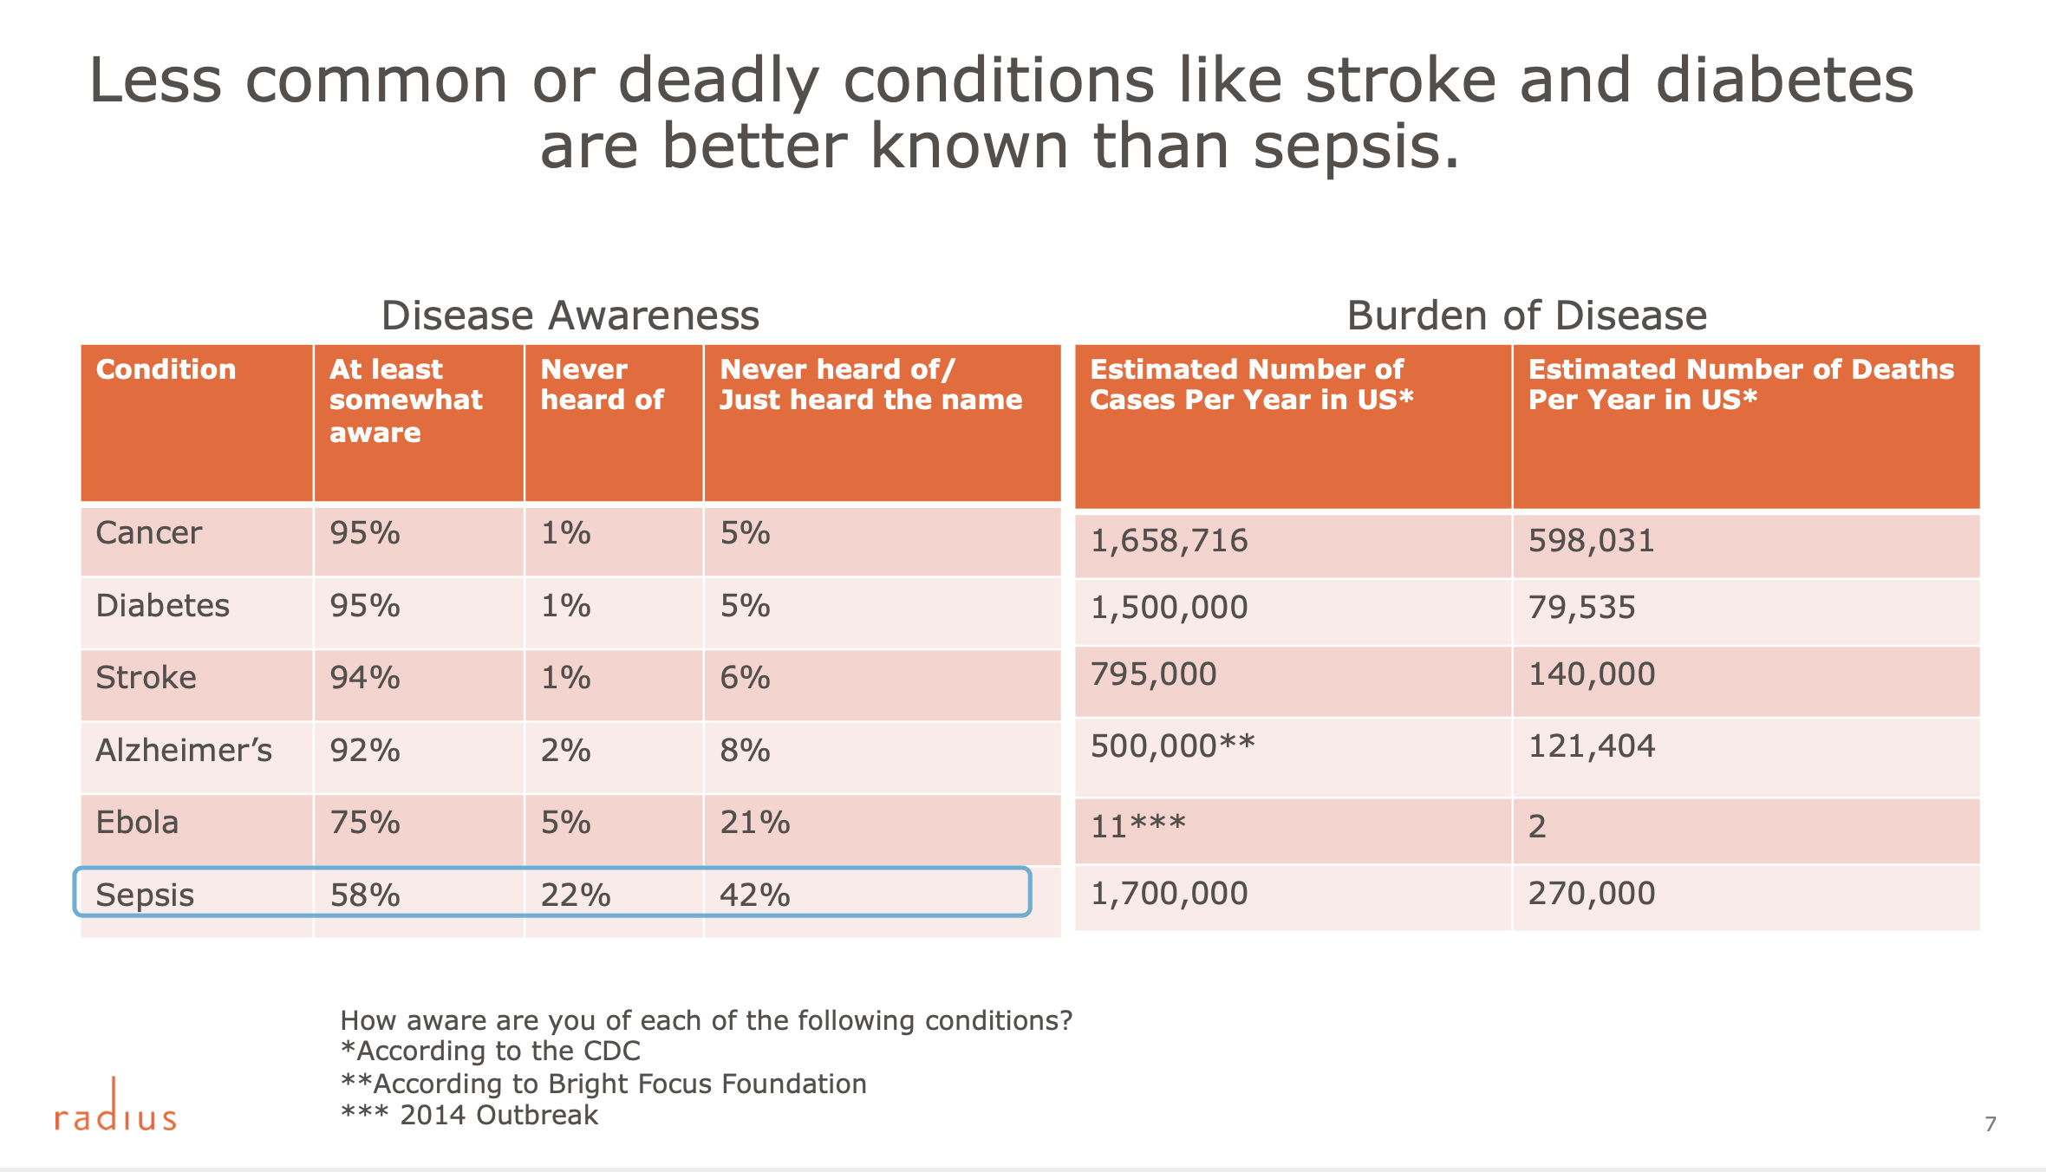

Slide 23
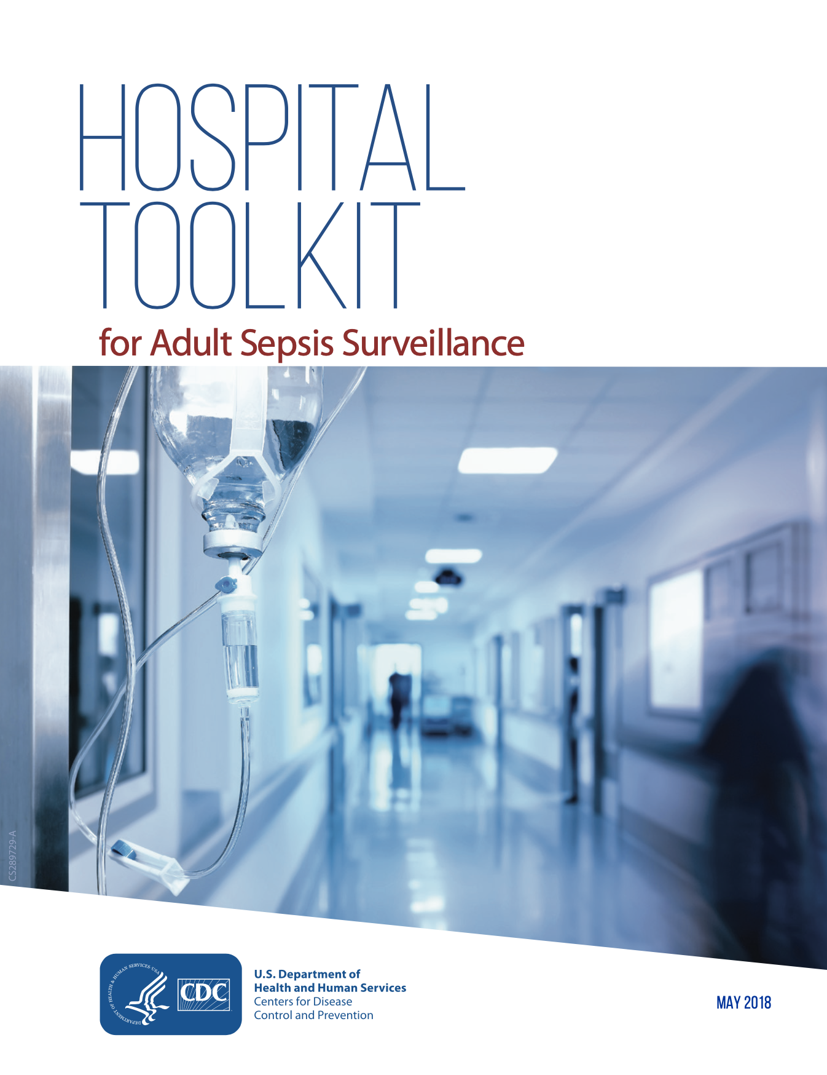

Common Language
Policy Changes

Slide 24
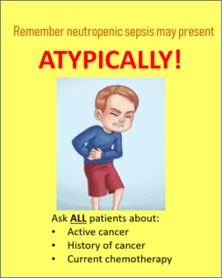
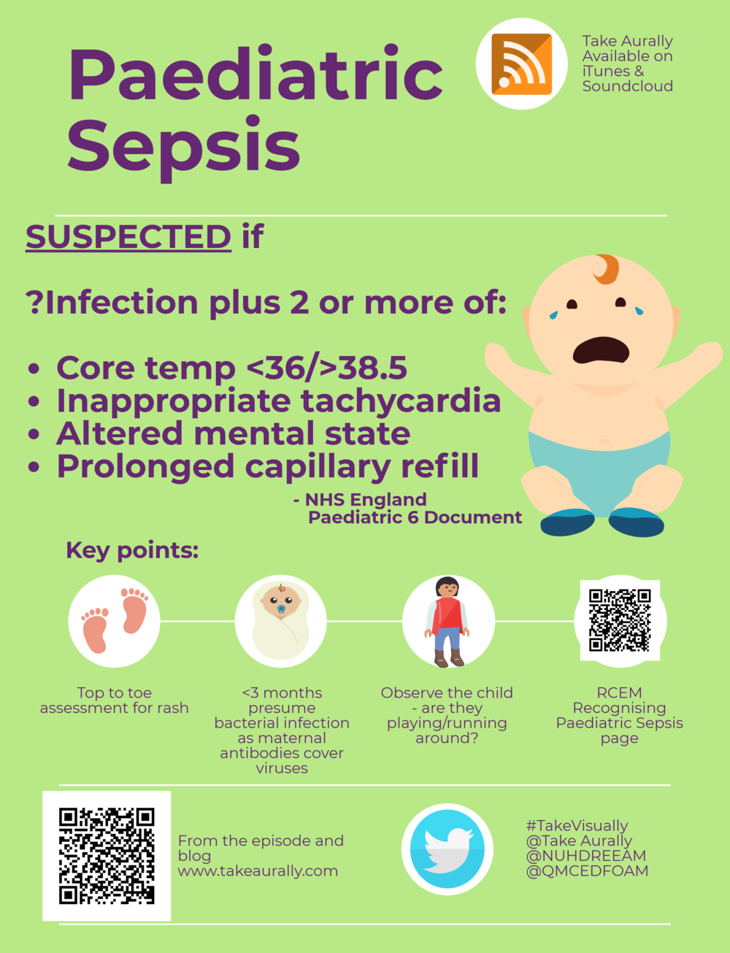
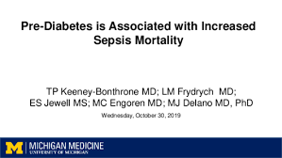
Finding your Partners

Slide 25


Harris County Public Health
{ Vision }
{ Values }
{ Mission }
Healthy People,
Healthy Communities,
A Healthy Harris County
Excellence
Compassion
Flexibility
Integrity
Accountability
Professionalism
Equity
Promoting a Health and Safe Community
Preventing Injury and Illness
Protecting You
#INVISIBILITYCRISIS | TWITTER: @USHAHMD @HCPHTX
WWW.HCPHTX.ORG

Slide 26

Acknowledgements
Dr. Umair Shah
Dr. Sherri Onyiego
Gwen Simms
Dr. Dana Beckham
Dr. Bujnowski
Dr. Saad Zaheer
Dr. L. Liu
Jennifer Kiger
Dr. Greg Hebert
Albert Cheng
Rachel White
Dr. Septimus

